Slide 1
Sprint 01
TadoSoft
Team JJJ
15, Jun, 2011

Slide 2
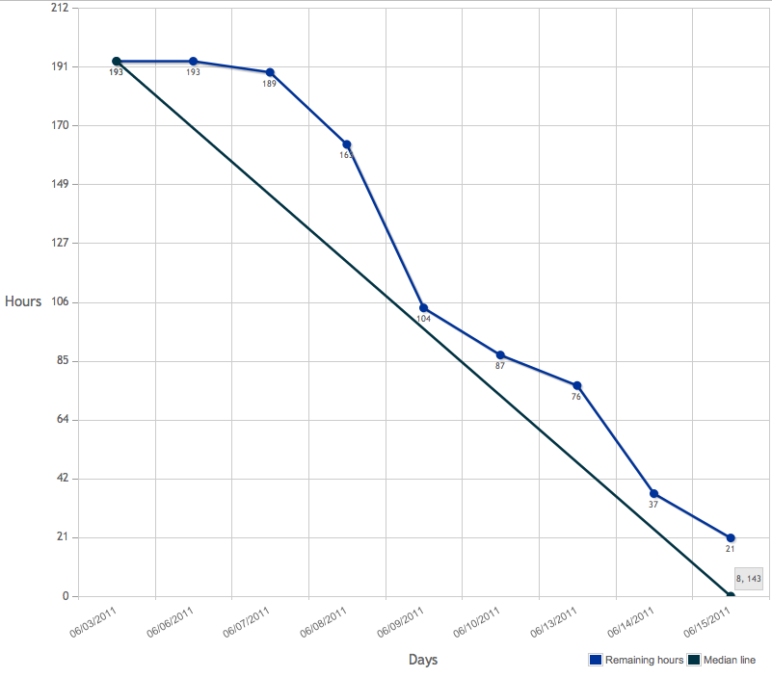
Burndown chart

Slide 3
DoD
Code
code style: Follow Xcode/Eclipse default style
complexity: <= 15 for each function (with hfcca or cyvis tool)
duplexity: <= 50 for each function (with CPD tool)
no fault
no warning
use DLog() instead of NSLog() in Obj-C
frozen version for every sprint with a GIT tag
Test
no leaks for Obj-C with XCode Instrument
Capacity&Performance test for server
unit test
Manually functional test
Document
class doc generated by Doxygen for every class, function, variable, constant with Javadoc style
design doc in word format, stored in GIT
Functional test cases(Precondition, Expect result, steps, Actual result, tester, date)

Slide 4
Committed Items
151 Server Setup
143 Database
153 Login
130 Login memory
144 signup
149 password recovery

Slide 5
Runtime environment
Intel i3 + 8G memory + Raid5 HD array
Ubuntu 11 (Linux core 2.6)
HTTP server: tomcat 7
Database: Mysql 5.1
iOS 4.3

Slide 6
Code Duplexity
The CPD tool doesn’t support obj-c language ☹
For java language, no warning

Slide 7
Code Complexity (objC on iPhone)
!!!! Warnings (CCN > 15) !!!!
==============================================================
NLOC CCN token function@file
--------------------------------------------------------------
97 18 351 parse@148@./Krowdit/JSON/SBJsonStreamParser.m
Total warning: (1/225, 0.4%)

Slide 8
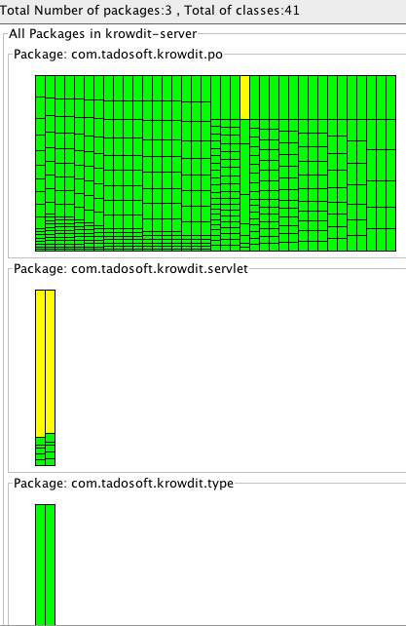
Code Complexity (java on server)
Green & yellow: complexity<=15

Slide 9
Document
Stored in git ssh://192.168.1.113/var/git/document

Slide 10
Issues
Potential leak of singleton object
Every function should have comments
Hibernate has a bug that is not connectable after 8 hours
No detection for broken network connection on iPhone
All settings & password should stored with NSUserDefaults
More error codes defined for servlet
Text field validation should be right after losing focus
Hide password as “*”
AlertShow is not necessary when successfully signed up

Slide 11
Q&A

Slide 12
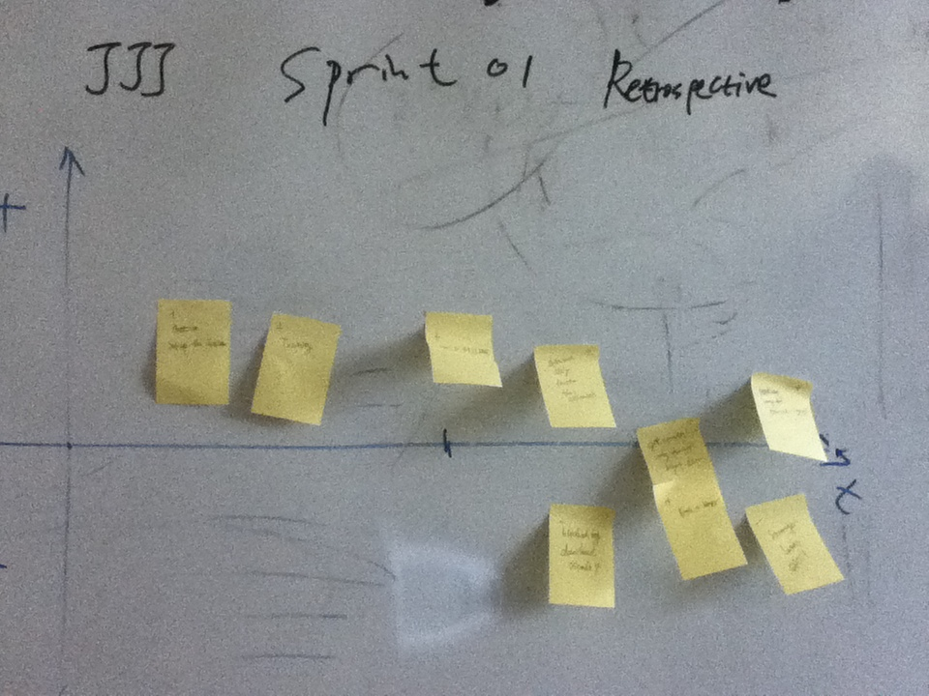
Retrospective

Slide 13
Retrospective
Trainer responsible for prepare material & practice & time management well before training
Tools improve efficiency
At least one reviewer before pushing code to server
Record designing idea on IceScrum, take task before daily meeting
How to manage knowledge base better?
AP to Jacky: Create a wiki on TripleJ server
Record Q&A as working tips
Way to ask question
Question need to be clear & focus
Try different solutions before ask
Take more look at other mature product’s design
Install product to user’s devices

